Slide 1
Discovering Exoplanets

Slide 2
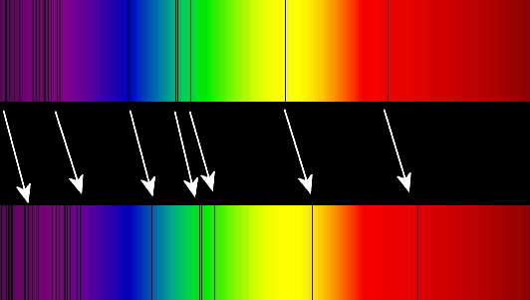
The spectral lines also tell you the star’s motion
CC BY-SA 3.0 TimothyRias and Adrignola

Slide 3
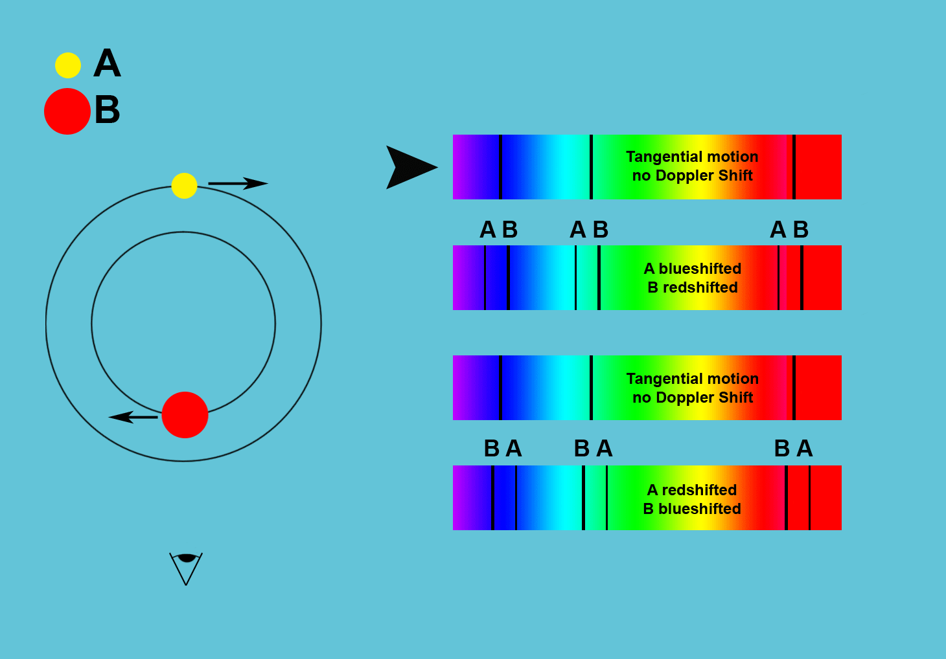
Same principle as spectroscopic binary stars…
Credit NASA
CC BY 3.0 Primefac
https://commons.wikimedia.org/wiki/File:Wiki_Spect_Binaries_v2.gif

Slide 4
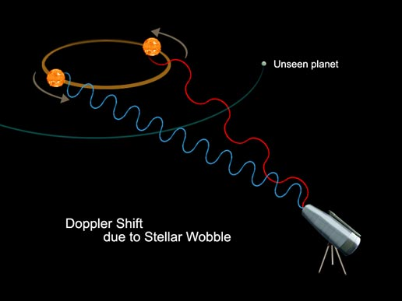
Stars are moved around by the gravitational pull of their planets
Credit NASA
Credit NASA
In this case, you only see the light of the star, NOT the planet

Slide 5
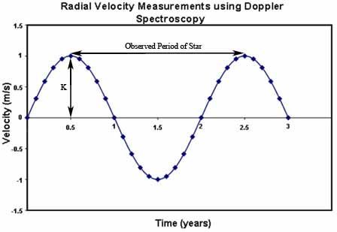
CC0 Dan Wingard

Slide 6
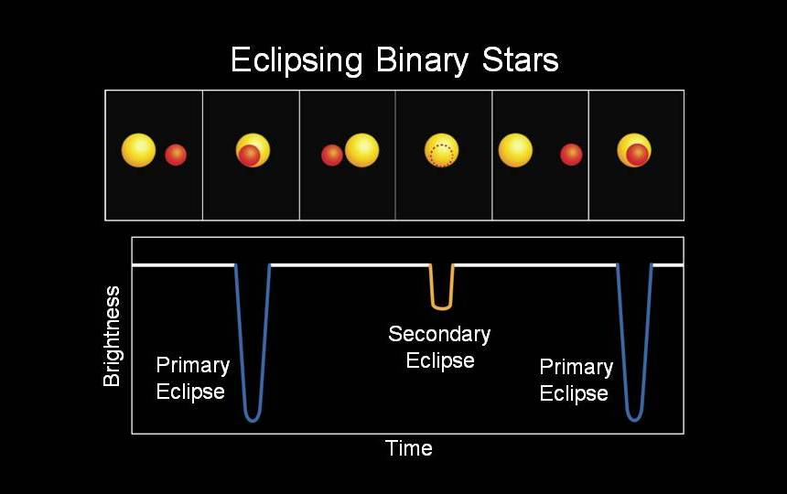
NASA
Just as eclipsing binary stars can be found…

Slide 7
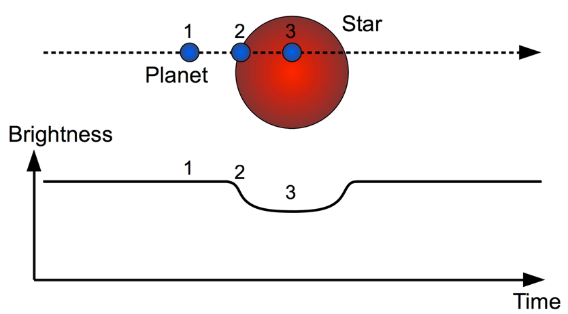
… exoplanets are found with transits

Slide 8
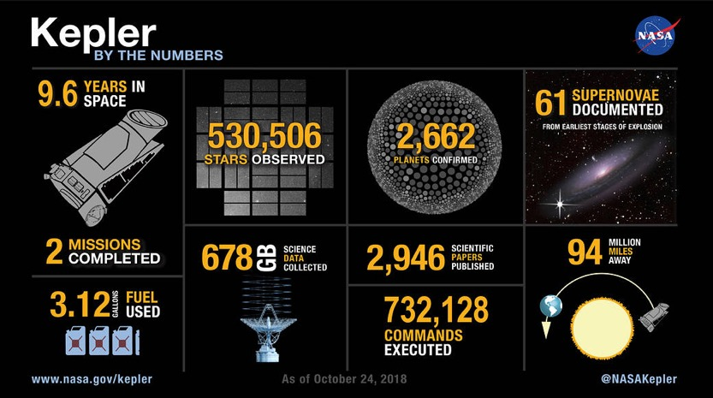
This spacecraft was used to successfully detect thousands of exoplanets using the transit method
Notes:
age, uv, stable, stable orbits, elements

Slide 9
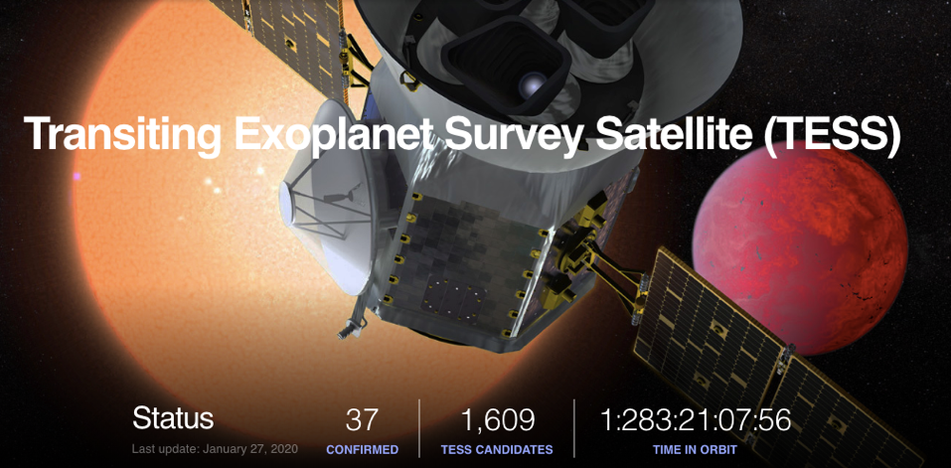
This current mission is also using the transit method to continue the work
https://exoplanetarchive.ipac.caltech.edu/

Slide 10
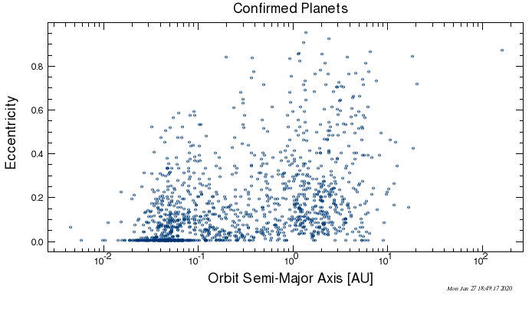
Orbital periods

Slide 11
Orbital periods
Mercury
Earth
Saturn
Neptune

Slide 12
Orbital periods
Mercury
Earth
Saturn
Neptune
Why do you think we have found more planets that are closer to their stars?

Slide 13
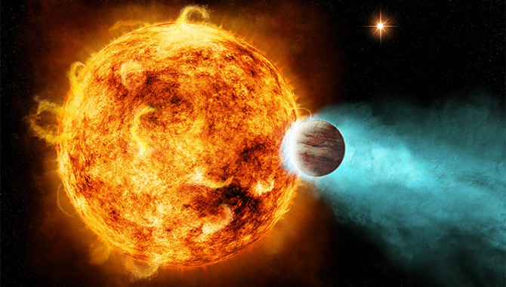
Artist’s Conception, NASA/Ames/JPL-Caltech
Many “hot Jupiters” likely got to where they are by planetary migration

Slide 14
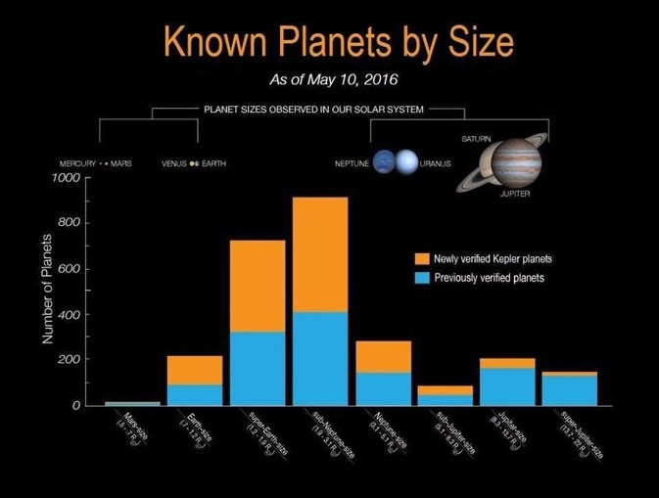
There are no “super-Earths” or “mini-Neptunes” in OUR Solar System

Slide 15
Highlights
Extrasolar planets, or exoplanets, are detected via many of the same methods as binary stars, particularly transit (eclipsing) and Doppler (radial)
The Doppler method measures the motion of the star as the exoplanet orbits it and gives you the mass of the objects
The transit method gives you the radius or physical size of a planet
The most easily detected systems have short orbits and large exoplanets
Exoplanet systems vary wildly from each other and from our Solar System

